Slide 1
Basics

Slide 2
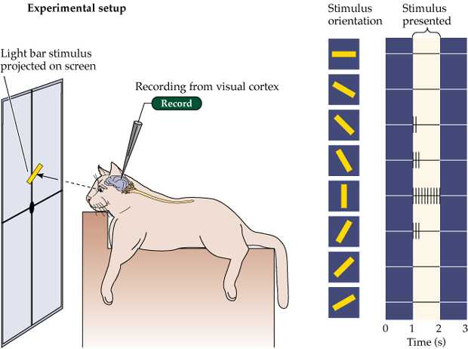
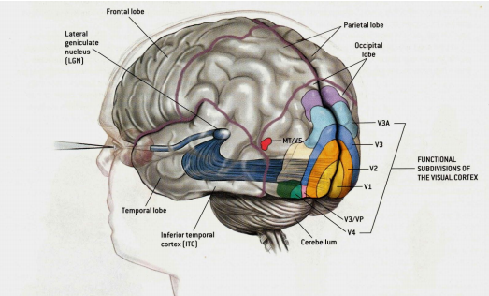
Building the intuition
Happens at the back of our brain. We have 4 core layers.
Our brain has several edge detectors (along with many other things)
Brain doesn’t see whole image at once , rather process and combine features

Slide 3
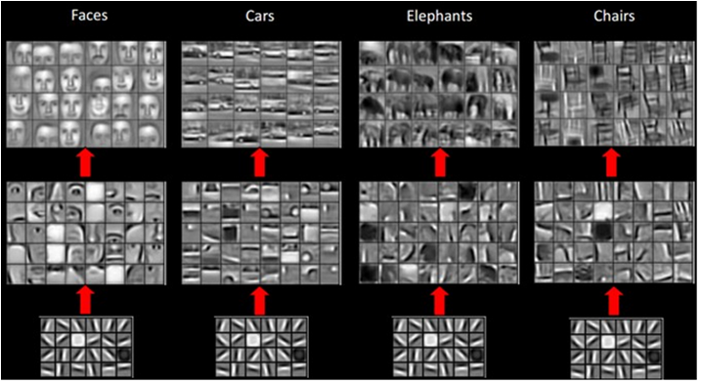
COMPLEX THINGS ARE BUILT FROM SMALL FEATURES
alphabets
Edges/gradients
words
patterns
sentences
parts of objects
stories
objects
when we are seeing an image, we are essentially seeing lots of distinguishable features together.
We need a way to extract these features

Slide 4
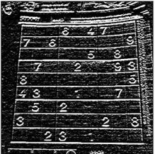
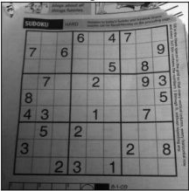
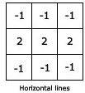
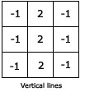
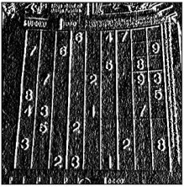
Kernels/Feature extractors And Channels/feature maps
http://setosa.io/ev/image-kernels/
H – edge channel
V – edge channel
Each kernel will extract one feature
Each channel will have similar info.
Multiple features – divide into multiple channels.
45 deg. – edge channel
135 deg. – edge channel

Slide 5

Let’s think of alphabets as features
Contains all ‘a’s
‘a’ kernel
We can divide the image into as many channels
No. of kernels will depend on the complexity of images.
More complex images will require more features and hence more kernels
‘b’ kernel
Contains all ‘b’s
Contains all ‘z’s
‘z’ kernel
http://scs.ryerson.ca/~aharley/vis/conv/flat.html

Slide 6
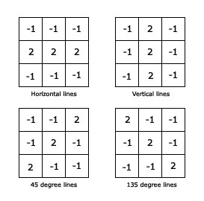

Kernel values??
What are the kernel values for V-edge, H-edge etc.?
What all edges/features to consider?
How simple/complex features should be?

Slide 7
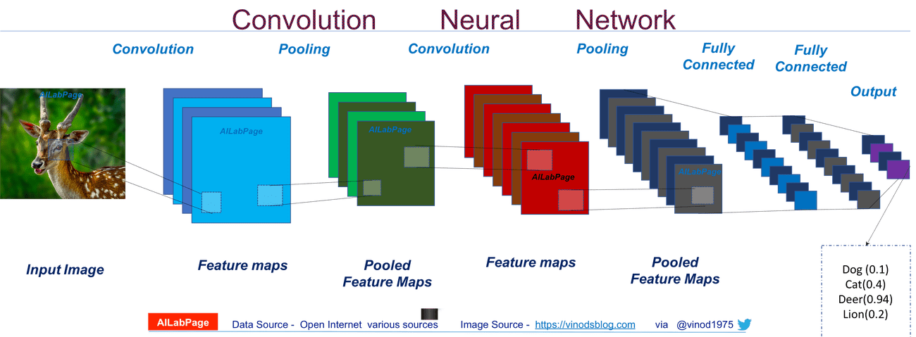
Kernel values – we train them

Slide 8
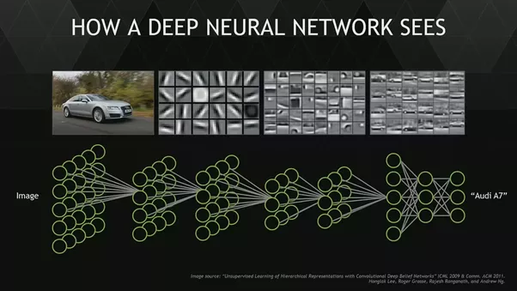
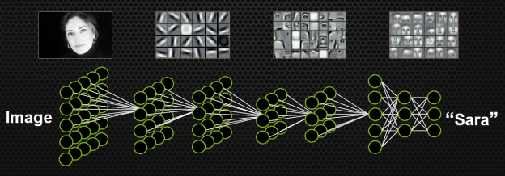
Can you imagine this happening
Initial layers will extract simple features(edges/gradients)
Middle layers will combine simple features to make patterns/parts of objects.
Final layers will combine middle level features to get objects and then finally detecting them.
Simple features can be same for different kinds of objects.

Slide 9
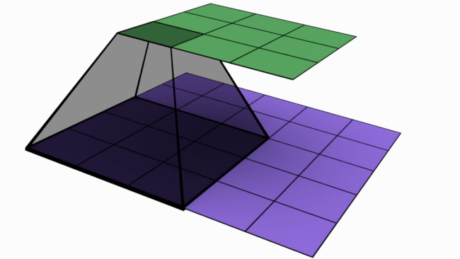
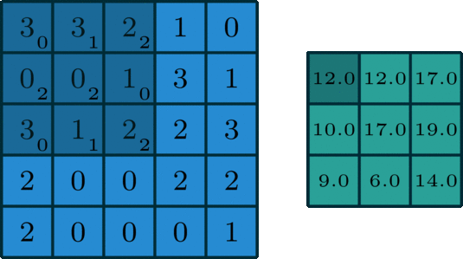
Convolution

Slide 10
Convolution through numbers
V – edge kernel
Output channel
Input image

Slide 11
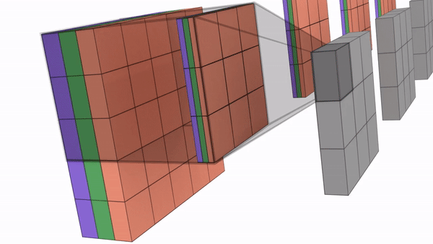
Understanding Dimensions
One kernel -> one output channel
# channels in kernel = # input channels
# output channels = # kernels
L1 -> 400X400X3 | (3X3X3) X 32 | 398X398X32 -> 864 params
L2 -> 398X398X32 | (3X3X32) X 32 | 396X396X32 -> 9216 params
Input image – 5X5X3
Kernels – (3X3X3) X4
Output – 3X3X4

Slide 12

Multi channel convolution

Slide 13
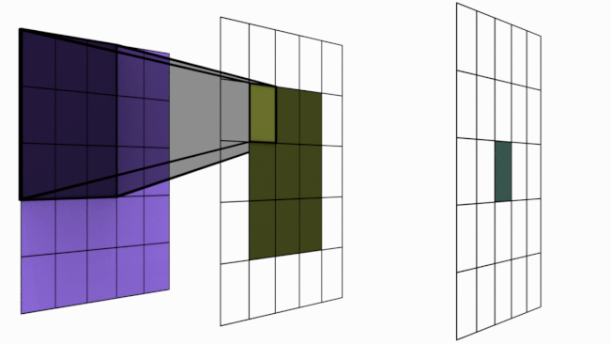
Receptive Field
RF – 3X3
RF – 5X5
RF – 1X1
Channel size – 5X5
Channel size – 3X3
Channel size – 1X1

Slide 14
How many layers to add?
21|19|17|15|13|11|9|7|5|3|1 -> (3X3) X 10 -> 90
21|17|13|9|5|1 -> (5X5) X 5 -> 125
21|15|9|3|1 -> (7X7) X 4 -> 196
21|13|5|1 -> (9X9) X 3 -> 243
21|11|1 -> (11X11) X 2 -> 242
21|1 -> (21X21) X 1 -> 441
Last layer will do the prediction.
Last layer should be able to see the whole image.
Let’s take an example :
Input size = 400X400, kernel size = 3X3
400 | 398 | 396 | …….. 200 layers -> not possible for GPU to handle
What we do:
400 | 398 | 396 | 394 | 392 | reduce channel size
196 | 194 | 192 | 190 | 188 | reduce channel size
94 | 92 | 90 ………….
How do we do that – Pooling

Slide 15
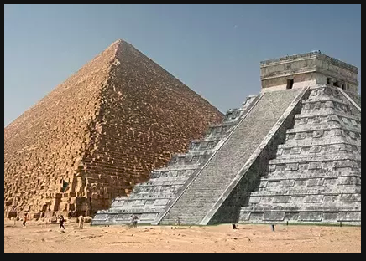
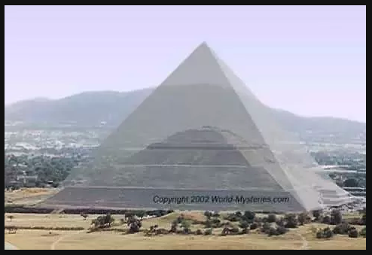

Slide 16
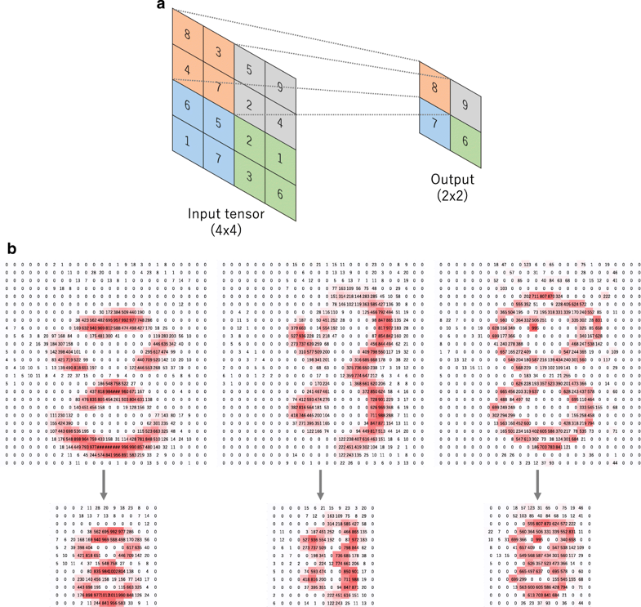

Max Pooling

Slide 17
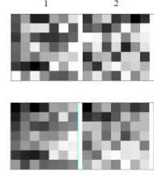
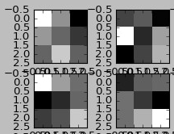
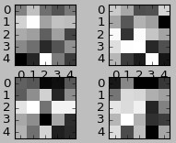
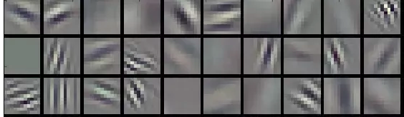
Where to add MP
RF – 7X7
RF – 3X3
RF – 5X5
We add pooling after few conv. Layers.
Typically in 400X400, edges form at 11X11 RF
RF – 11X11

Slide 18
Reducing # channels
400x400x1 | (3x3)x32 | 398x398x32 398x398x32 | (3x3)x64 | 396x396x64 396x396x64 | (3x3)x128 | 394x394x128 394x394x128 | (3x3)x256 | 392x392x256 392x392x256 | (3x3)x512 | 390x390x512 MaxPooling
195x195x512 | ()X32
## channels per image = 32+64+128+256+512 ~ 1000
We need to reduce # channels
We do it after Max pool layer
Idea is we need to carry forward only relevant combination of features.
We follow increasing – decreasing kind of structure.

Slide 19
Thank You

